Slide 1

Harmony High School
2024-2025 Senior Parent Night Presentation

Slide 2

Administration
Principal: Mr. Hickey
Assistant Principal: Mr. Hoyle
Assistant Principal: Mrs. Ramsey
Assistant Principal: Mrs. Reda
Assistant Principal: Mrs. Yontz

Slide 3
Senior Class Sponsor
Jessica Thelen
Jessica.Thelen@osceolaschools.net

Slide 4
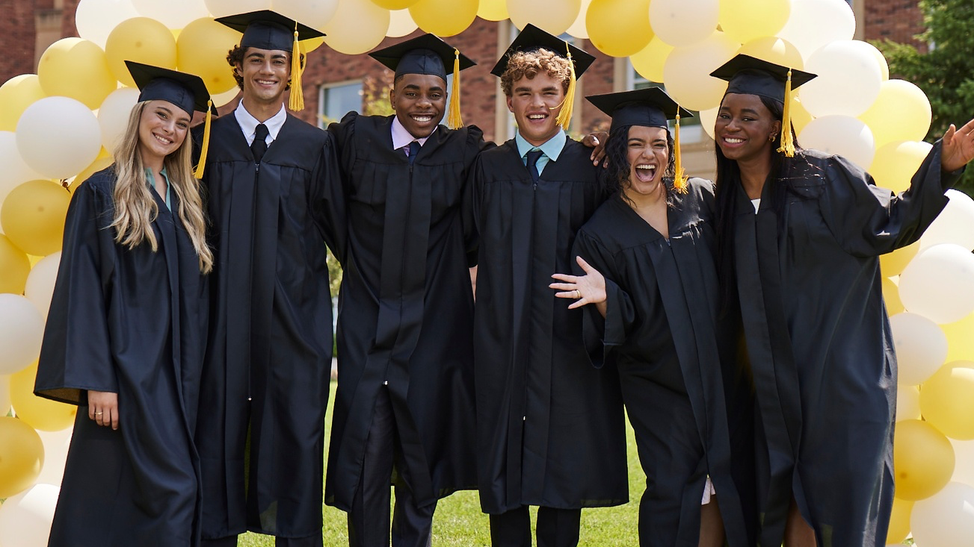
Welcome,
Class of 2025!
Harmony High School
Notes:
· I’ll be stopping by throughout the school year — feel free to say “hi” or ask me questions.
· Remember, seniors:
o This is YOUR graduating class.
o This is YOUR year.
o Everything has led to THIS, so enjoy it... TOGETHER.

Slide 5

Ryan Comparato
YOUR LOCAL JOSTENS REP
Notes:
· My name is ___ and I’m your local Jostens rep. I’ve been doing this for __ years now, and I’m so excited to spend some time with you today.
· Rep Actions:
o Share a personal story from your senior year that will help them understand the importance of — and excitement surrounding — this moment/year in their life.
o Bonus: Explain why you chose this career (and why you show up at their school every year).
· I’d like you to remember two very important dates:
o Your class’s order deadline is Friday, September 20th
o Your Senior Celebration will take place on Friday, October 11th. This is an amazing event where you will receive your brand-new ’25 apparel as a class.
§ Rep Action: Explain what their Senior Celebration will look like/how do you do Senior Celebrations at your schools.

Slide 6

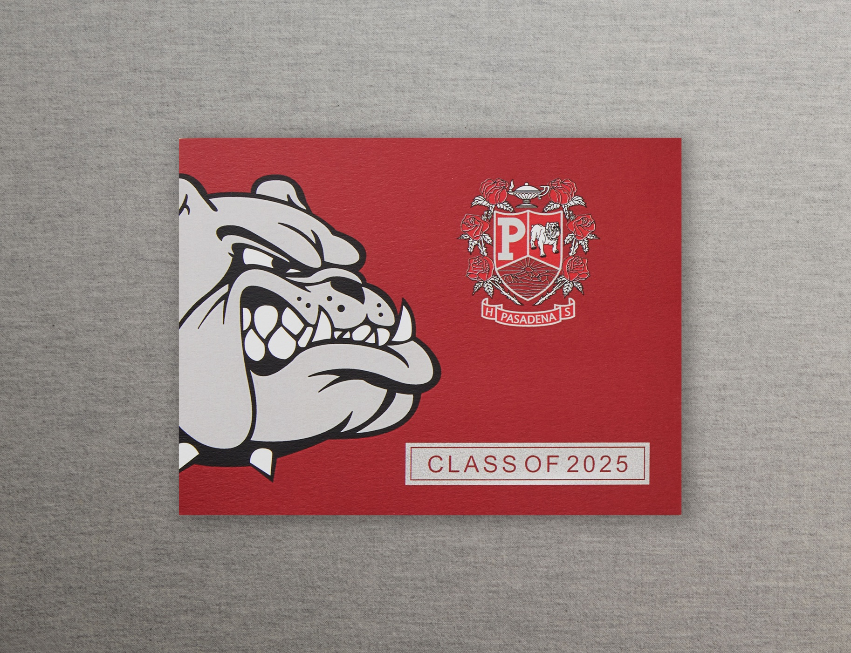
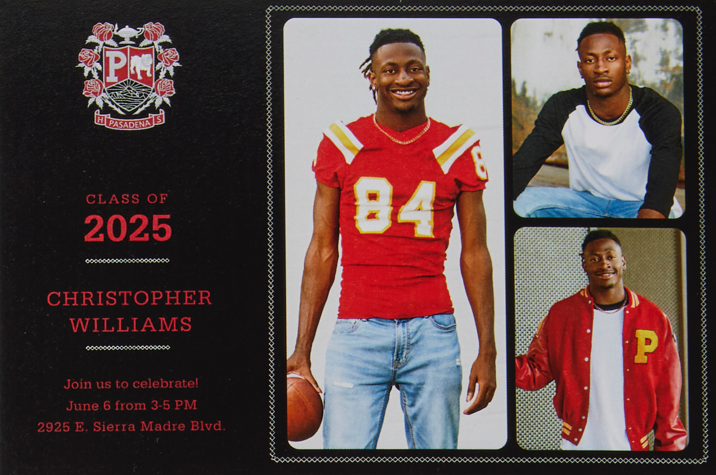
Graduation Announcements.
MASCOT ANNOUNCEMENT
OR
TRADITIONAL ANNOUNCEMENT
PHOTO CARD
Notes:
· Your school offers something very special — you’ll have the opportunity to choose which kind of announcements you want!· If you prefer a traditional and elegant look, order the traditional announcements.· If you prefer a bold and modern look, go for the mascot announcements.
· No matter which design you choose, you’ll be able to purchase coordinating envelope seals, return address labels and thank you notes — your parents will appreciate that!

Slide 7
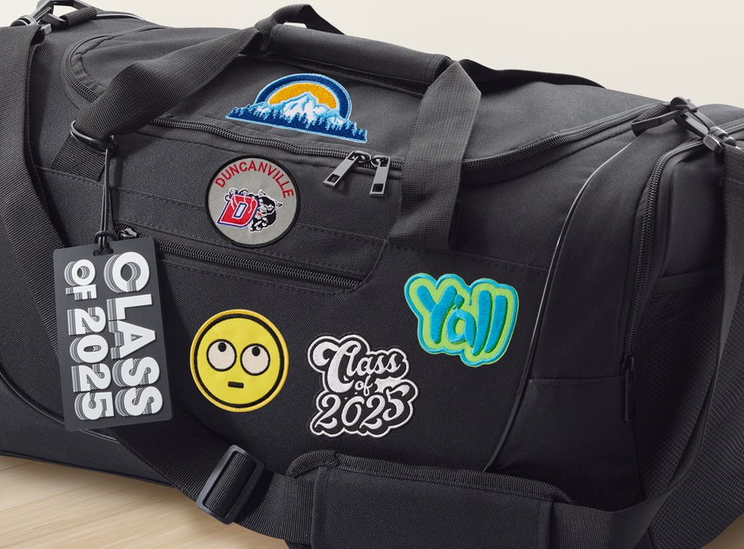
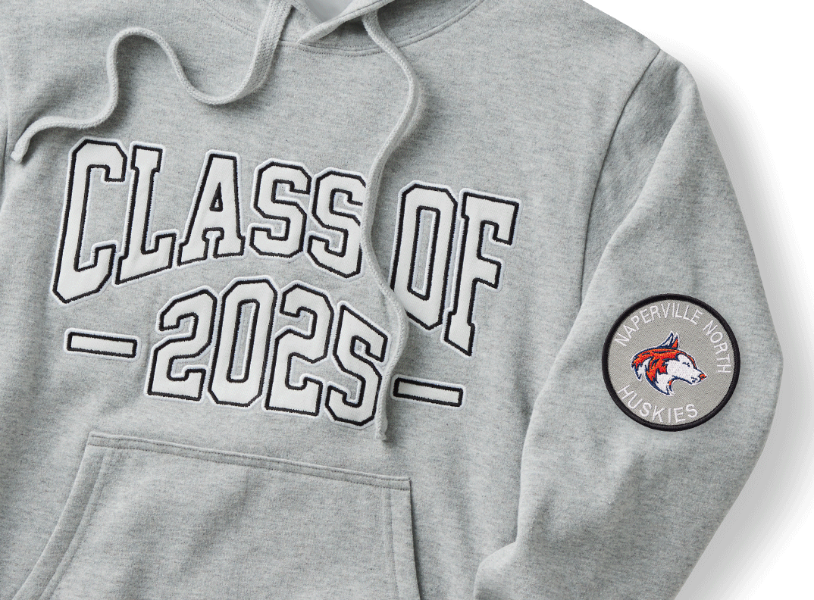
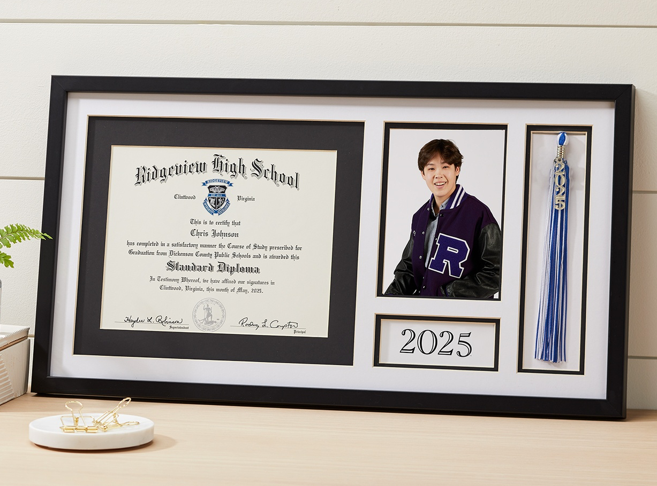
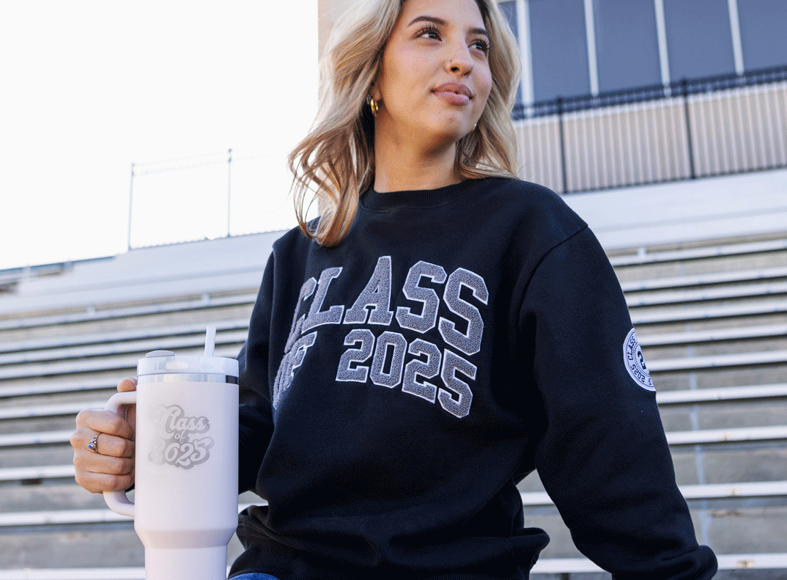

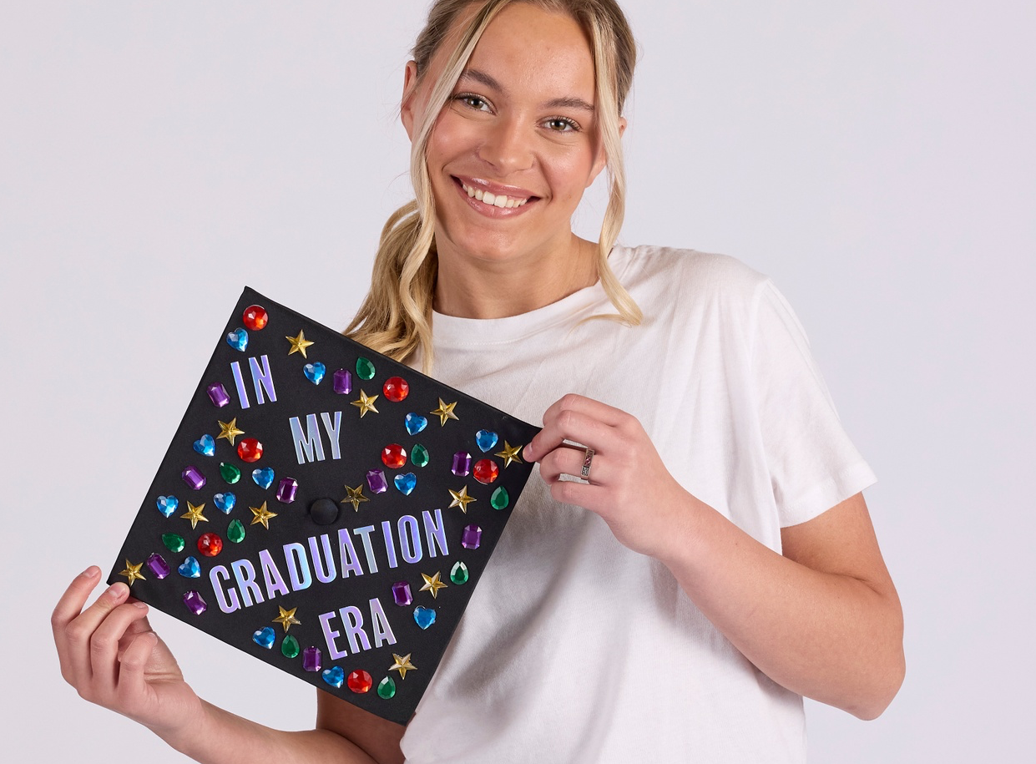



Notes:
· There are many different ways to order your senior gear. o Some of you may purchase products a la carte.o Most of you will order a grad package.o The easiest way to get everything you need for senior year is to order the Mascot Package.· Your school’s EXCLUSIVE Mascot Package includes:o The apparel and keepsakes you want.o The products your parents care about.o The two things that you will need on graduation day: your cap and gown!· This package has been discounted so you can get the full senior experience for less.
o All you have to do is order by your class’s deadline!Video Lead-In: Let’s take a look at all the cool items in your school’s Mascot Package.

Slide 8



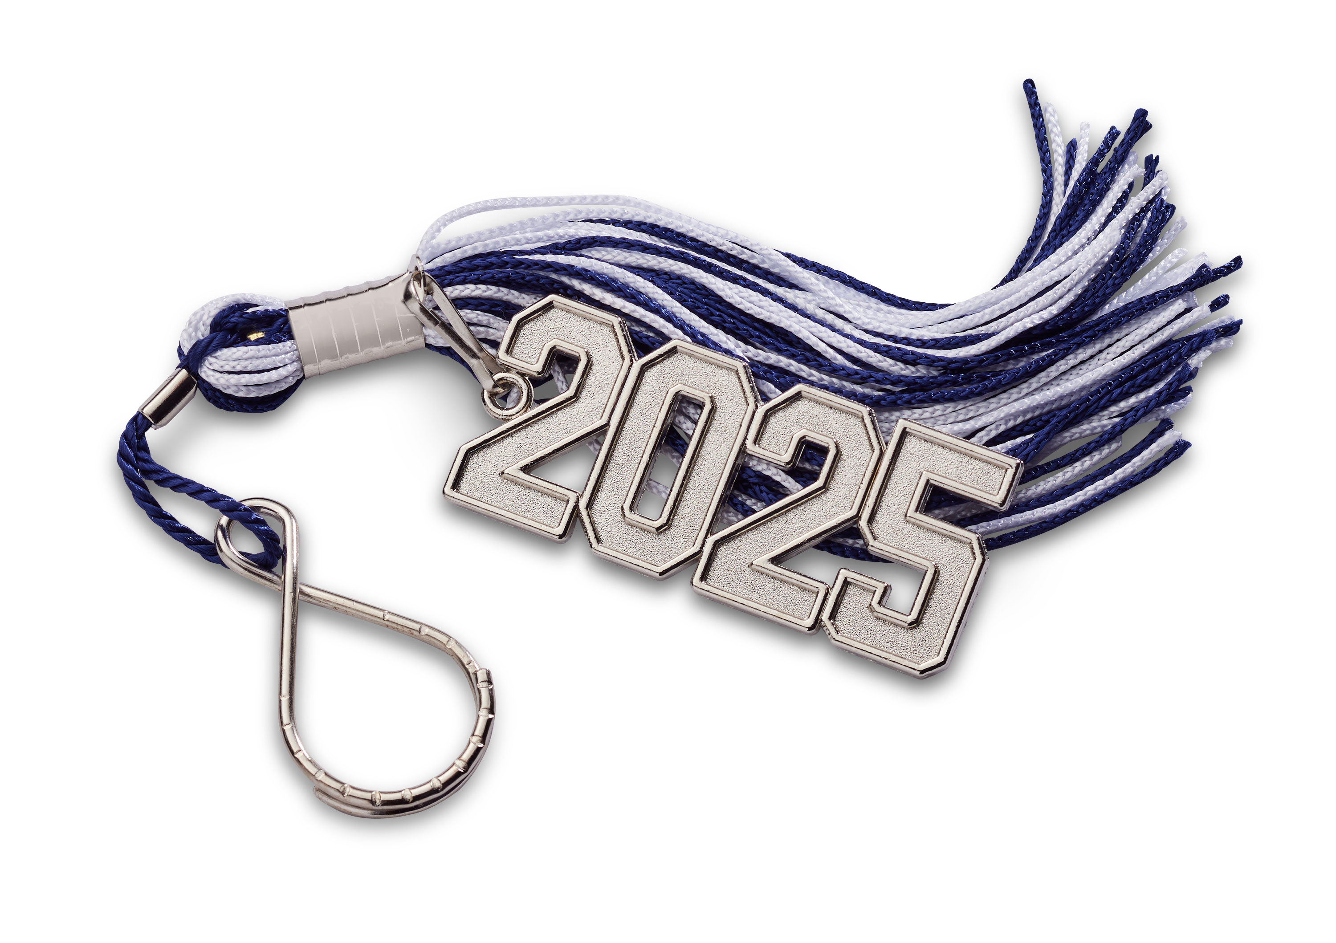

Extra Tassels
Ordered online and delivered with your Cap & Gown.

Slide 9
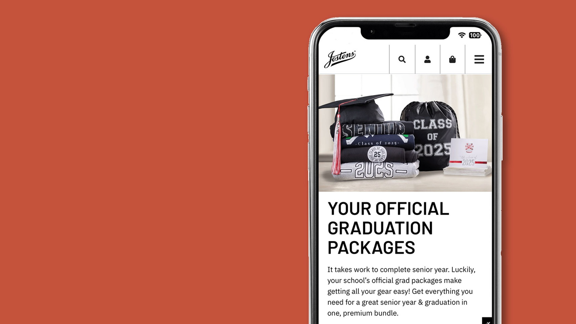
There’s more
’25 gear to
explore.
SEE EVERYTHING AT JOSTENS.COM
Notes:
· You can purchase everything we’ve talked about today at Jostens.com.
· Keep in mind that I’ve only shown you a small portion of what we offer.
o Head to our website — and find your school store — to check out additional Class of ’25 apparel, accessories and keepsakes!

Slide 10
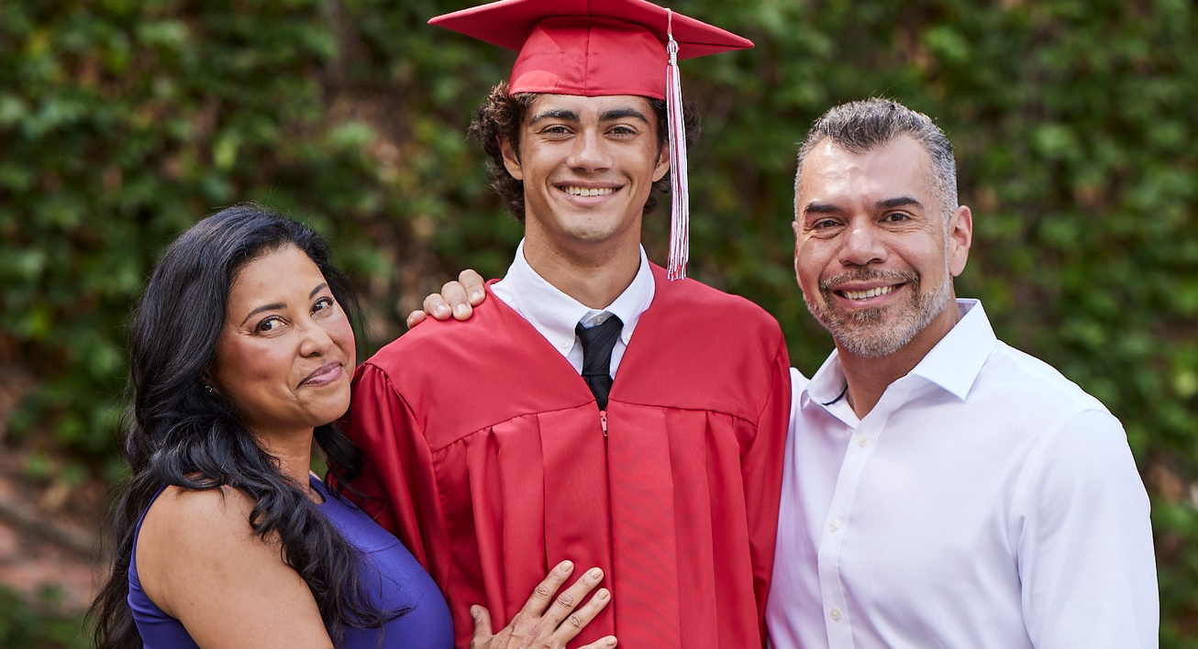
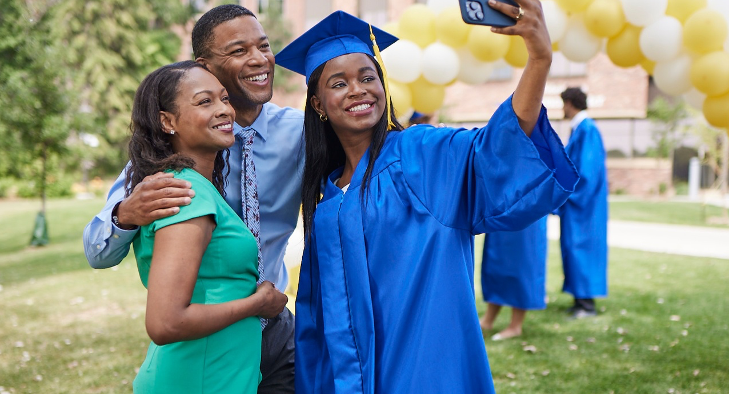
Cap & Gown
Height & Weight
Notes:
· Let’s take a moment to loop your family in on what we’ve been talking about today.
· A parent or guardian will most likely be paying for your senior year and graduation needs, so they’ll need to know what’s available and when you need to place your order.
· Scan the QR code on the screen to send them a quick text that will fill them in on the details.

Slide 11
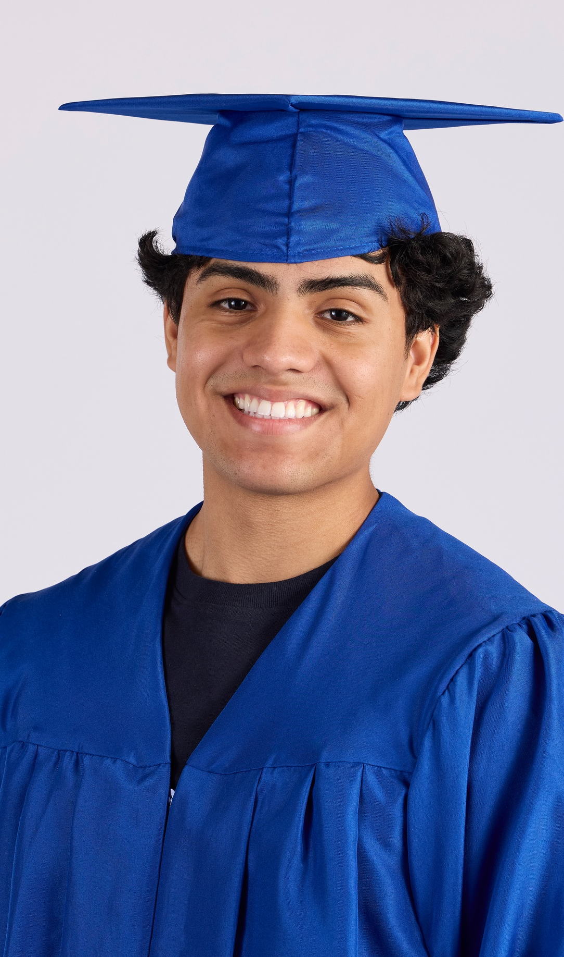
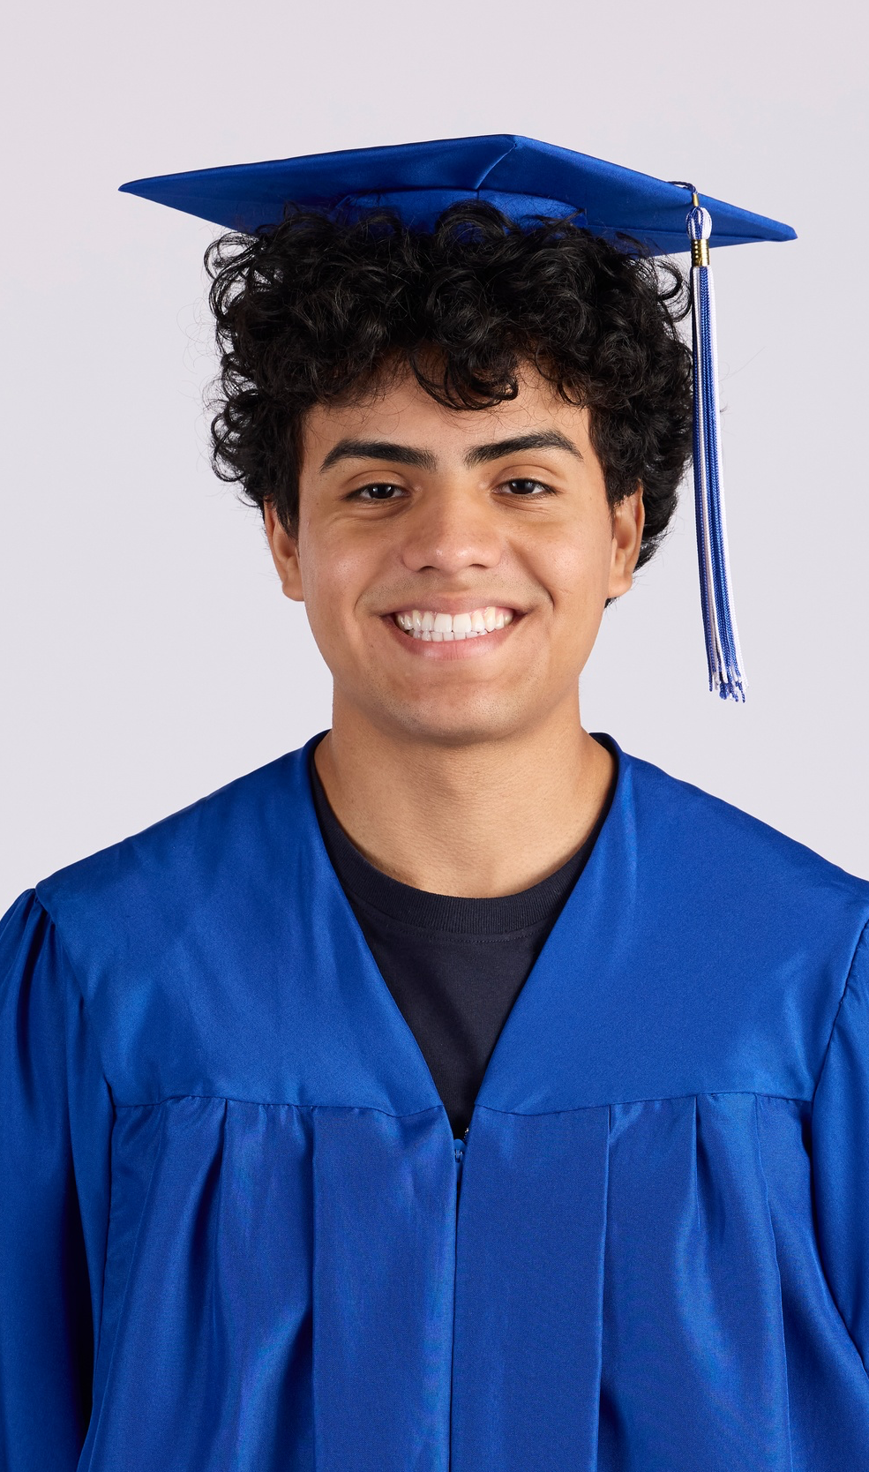
Grad Cap Companion
Celebrate this milestone while feeling your best!

Slide 12

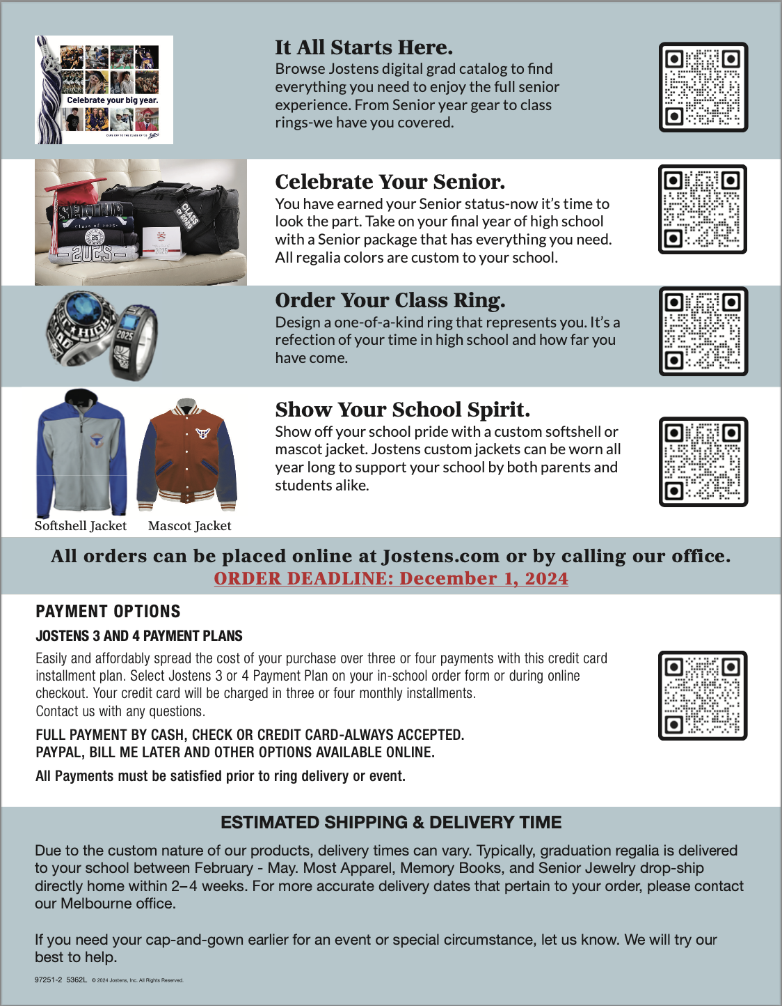

Slide 13
1st Semester
Senior Events
Sept. 3rd – Spring DE Application opens
Sept. 16th – Sept. 20th – College Week (themed days)
Sept. 24th – ASVAB (Sign-Ups have closed, but student can email Mrs. Barton if they still want to test)
FAFSA Appts – Oct. 1, Oct. 22, Nov. 5, Nov. 19, Dec. 3 (all appts are from 10 am – 1 pm, Sign up in Guidance)
Oct. 1st – Bright Futures Application opens
Oct. 3rd– DE Application closes
Oct. 8th – Sr School Day SAT
Oct. 22nd – Math PERT for DE
Oct. 23rd – Reading/Writing PERT for DE
Oct. 31st – Yearbook Senior Picture Deadline (Bruce Wilson)
Nov. 1st – Education Foundation Scholarship Application Opens
Nov. 8th – DE PERT Scores Due to Valencia

Slide 14
2nd Semester
Senior Events
7 Jan.
FAFSA Help Appts – Jan. 7, Jan. 21, Feb-Apr dates TBD (Students sign up in Guidance)
5 Apr.
Grad Bash @ Universal
April
Cap/Gown Distribution
23 Apr.
Education Foundation Scholarship Awards Ceremony
25 Apr.
Decision Day Celebration
26 Apr.
Prom
21 May @ 1:30 pm
Graduation @ Osceola Heritage Park
May
Senior Academic Awards Ceremony @ 6pm

Slide 15

Deadline Oct. 31, 2024

Slide 16


Slide 18

Senior Yearbook Questions?
Oct. 31st – Sr Picture Deadline
Any other questions, please email
Corinne.Molineaux@osceolaschools.net

Slide 19

GUIDANCE
Who do I see?
Mrs. Tart Manuela.Tart@osceolaschools.net A-CE
Ms. Holden Deana.Hetherly@osceolaschools.net (until Oct/Nov) CH-GA
Ms. Yaeger Madison.Yaeger@osceolaschools.net GE-L
Mrs. Hetherly Deana.Hetherly@osceolaschools.net M-P
Mrs. Lineburgh Gloria.Lineburgh@osceolaschools.net Q-SL
Mrs. Carrasquillo Angelina.Carrasquillo@osceolaschools.net SM-Z
Mrs. Barton Cathy.Barton@osceolaschools.net College/Career
Mr. Rosario Victor.Rosariojr@osceolaschools.net Valencia Coach
Mrs. Cummings Ashley.Cummings@osceolaschools.net Social Worker

Slide 20
Graduation Requirements
Credits
GPA – 2.0 unweighted or higher
Testing
Algebra 1 EOC (3 or higher)
FAST ELA (3 or higher on 10th grade test)
Geometry, Biology & U.S. History EOC (30% of final grade)
Concordant Scores
SAT Math 420, PSAT Math 430, ACT Math 16
SAT English/Reading 480 or ACT Reading & English Avg 18
4 English
4 Math (Algebra 1, Geometry & Higher)
3 Science (Biology & 2 others)
1 World History
1 U.S. History
.5 Economics (1 semester)
.5 U.S. Government (1 semester)
1 PE (Semester of Personal Fitness & PE Elective)
1 Fine or Practical Arts Class
8 Electives
*Senior Credit Checks Started Aug. 30th

Slide 21

GUIDANCE
Need HHS info???
Sign Up for
Freshmen text @28harmony to 81010
Sophomores text @27harmony to 81010
Juniors text @26hhs to 81010
Seniors text @25harmony to 81010

Slide 22

Senior School Day SAT
October 8, 2024
Students registered by district
Free
Digital (need to bring charged district issued computer)

Slide 23

College Applications

Slide 24
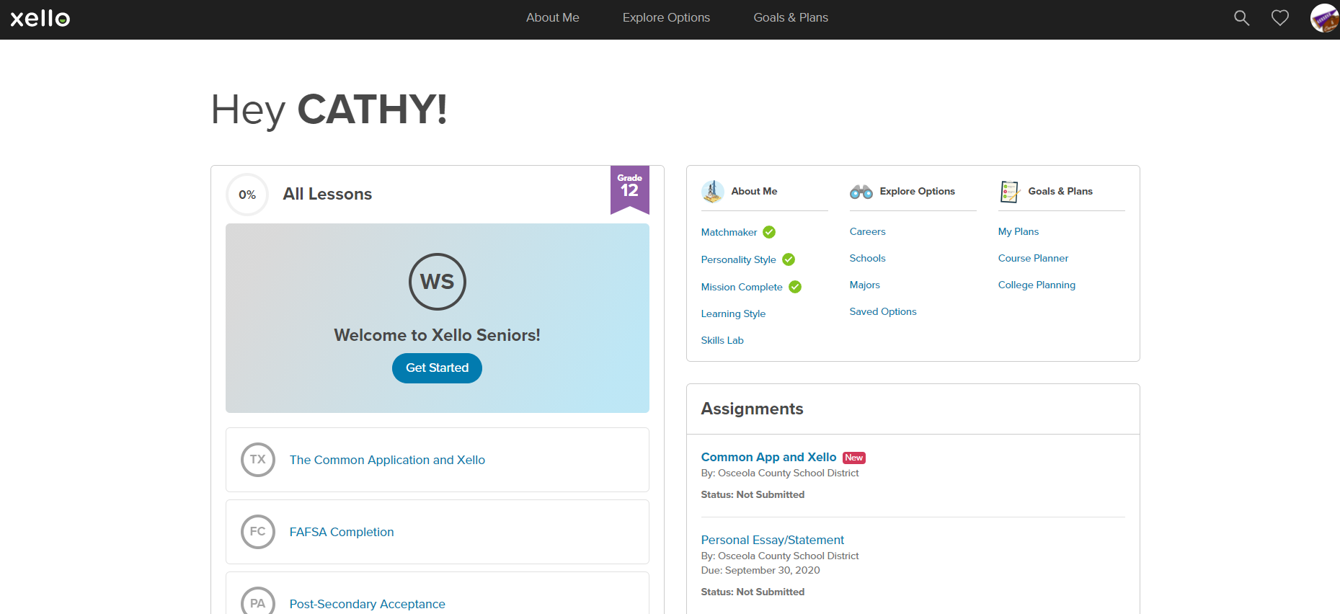


GUIDANCE

Slide 25
College Application Deadlines
4-Year Universities – Oct. 15th-Nov. 1st
Merit Scholarship $
Fall Term Seats Fill Quickly
Everyone Applies First Time in College Freshman
Regular Decision, Early Action, Early Decision, Rolling
2-Year and Technical Colleges – Jan. 1st
Allows Time to Submit Required Documents

Slide 26
Valencia Coach
Victor Rosario – Victor.Rosariojr@osceolaschools.net
In Guidance every Tuesday and every other Friday
Assist with the Valencia applications, scholarships and special programs

Slide 27
DE/AA Reminders
*If you graduate with AA, you are not applying Direct Connect to UCF.
*You may choose Test Optional with AA, but may exclude you from Merit Scholarships.
*All DE students apply as 1st time Freshman & considered as a Freshman first then as a Transfer student second
*DE continuing at Valencia, must provide Florida Residency documentation and submit FAFSA.

Slide 28
Military Enlistment
Air/Space Force, SSGT Martinez, 321-403-1029
Army, SSGT Rice, 785-317-4343
Coast Guard, Petty Officer Arroyo Colon, 407-960-0962
Marine Corps, SSGT Elzinga, 321-436-0490
National Guard, SSGT Otero, 561-302-5092
Navy, Petty Officer Butler, 352-634-2164

Slide 29
ASVAB Testing
September 24, 2024
Students register by emailing Cathy.Barton@osceolaschools.net
Free
Juniors & Seniors Only

Slide 30
Paying For College
FFAA (Florida Financial Aid Application) aka Bright Futures
Application opens Oct. 1st
Do not need to qualify to apply
Can only be used for schools in Florida
FAFSA:
Application for Fall/Spring Term 25-26 opens Dec.
Application for Summer Term 24-25 open now
*Help Appts. will be available starting in Oct.
Scholarships:
Local
Education Foundation opens Nov 1st
Additional ones in Xello, Remind
National
GoingMerry.com
Scholarships.com
Big Futures (thru College Board)
Xello

Slide 31
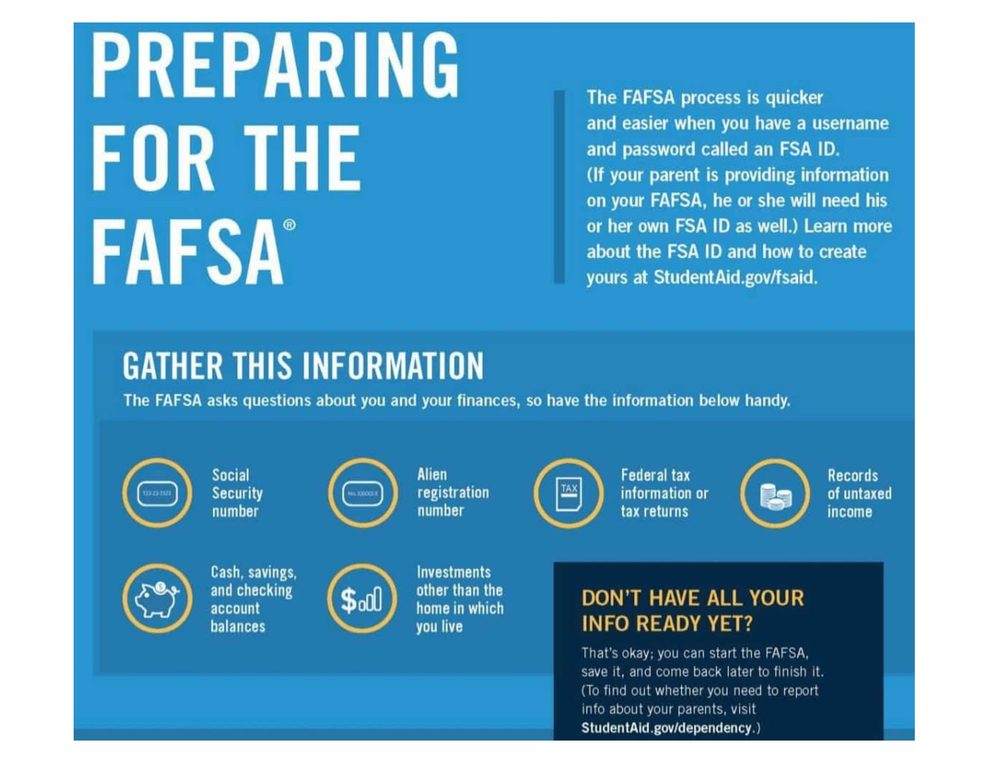

Slide 32
Thank you
Have a great school year!!

